Slide 1

Nuclear astrophysics
Fingerprints of the stars
http://mc.chetec-infra.eu
This project has received funding from the European Union's Horizon 2020 research and innovation program under grant agreement No 101008324 (ChETEC-INFRA)

Slide 2
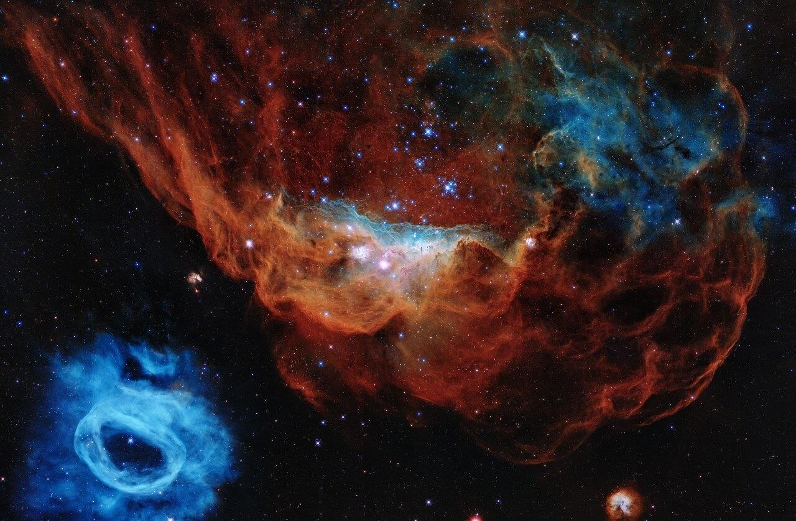
Nuclear astrophysics
Fingerprints of the stars

Slide 3
Time Schedule
Time | Content
30' | Introduction
15' | Part I Atomic Nuclei & their Peculiarities
10' | Break
30' | Part II Stellar evolution
60' | Part III Primordial Nucleosynthesis
30' | Lunch break
90' | Part IV Fingerprints of the stars
10' | Break
75' | Part IV Fingerprints of the stars - Continuation
15' | Conclusion

Slide 4

Brainstorming
Task
Open the
1. Brainstorming Board

Slide 5
What is
Nuclear Astrophysics
actually?
Notes:
Notes for intermediaries:
Record the students' answers to this question on the brainstorming board and discuss them before giving the definition.
The question slides are used repeatedly to structure the masterclass and give it a common thread. They aim to motivate and introduce the following content

Slide 6
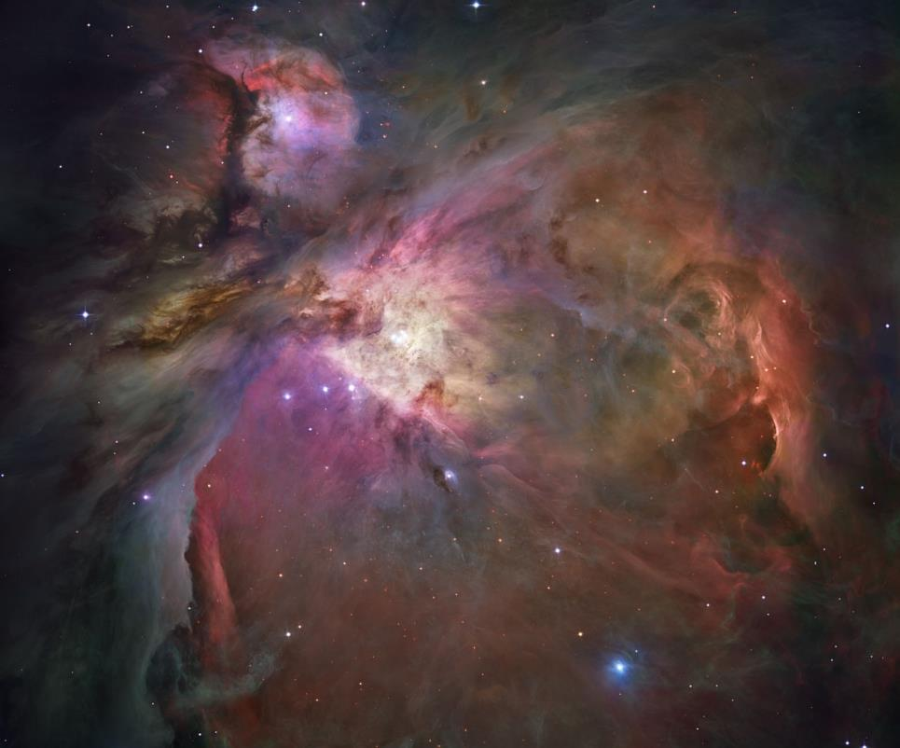
What is nuclear astrophysics?
Nuclear astrophysics investigates the origin of chemical elements.
Nuclear astrophysics takes a deep look into the universe to answer this question.
[02] Orion Nebula, ESA/Hubble
Notes:
Notes for intermediaries:
A definition is used here that serves as a common thread for the masterclass.
If you wish, you can replace this definition with a more general and scientifically precise definition.

Slide 7
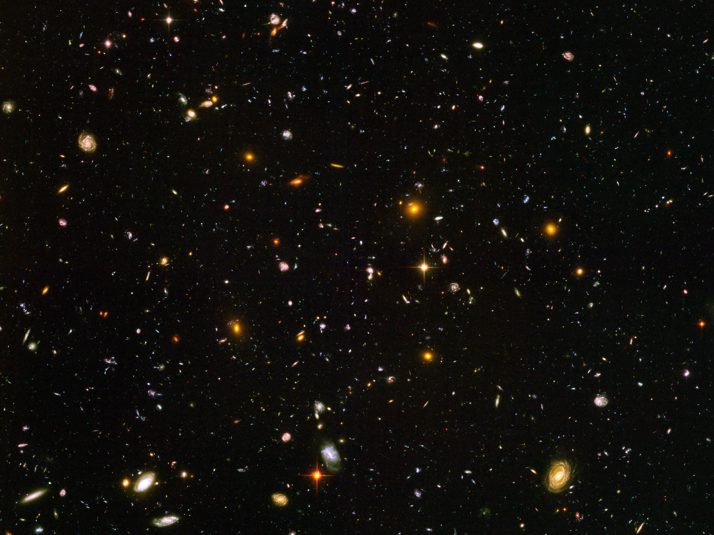

Slide 8
What is a
chemical element?
Notes:
Notes for intermediaries:
The following short lecture serves to discuss the development of the idea of chemical elements over the centuries and to derive the modern image of a chemical element.
Nature-of-Science aspect:
In addition, you can use the metaphysical ideas to show what modern science is about and discuss with the students why the approaches do not meet scientific quality criteria from today's perspective.

Slide 9
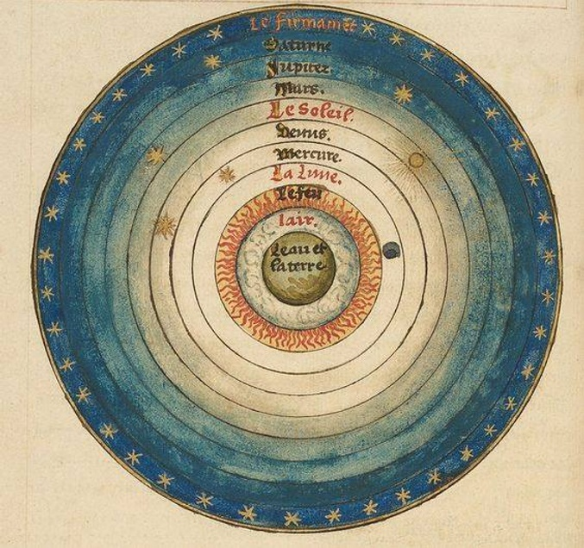
Elements in antiquity (ca. 350 BC)
The Aristotelian cosmos
The geocentric idea of an onion-skin cosmos
The four earthly elements form matter
The fifth element ether fills the sky
Every substance is made up of the elements, the composition determines the properties of the substance
All celestial bodies move by themselves
  Initial movement caused by a motionless mover
[04] The Sphere of the World, by Oronce Fine, 1549

Slide 10
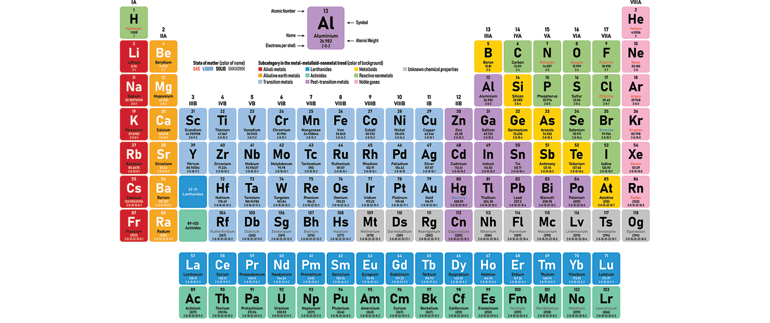
The periodic table of the elements

Slide 11
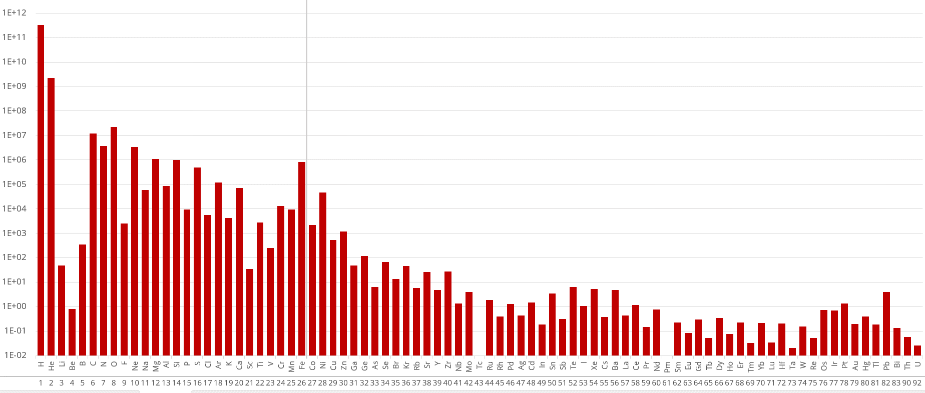
Abundance of chemical elements (solar system)
Relative frequency (logarithmic)
Ordinal number Z
Notes:
Notes for intermediaries:
Explain the logarithmic scale!
chemical abundances are one of the most important observations in nuclear astrophysics

Slide 12
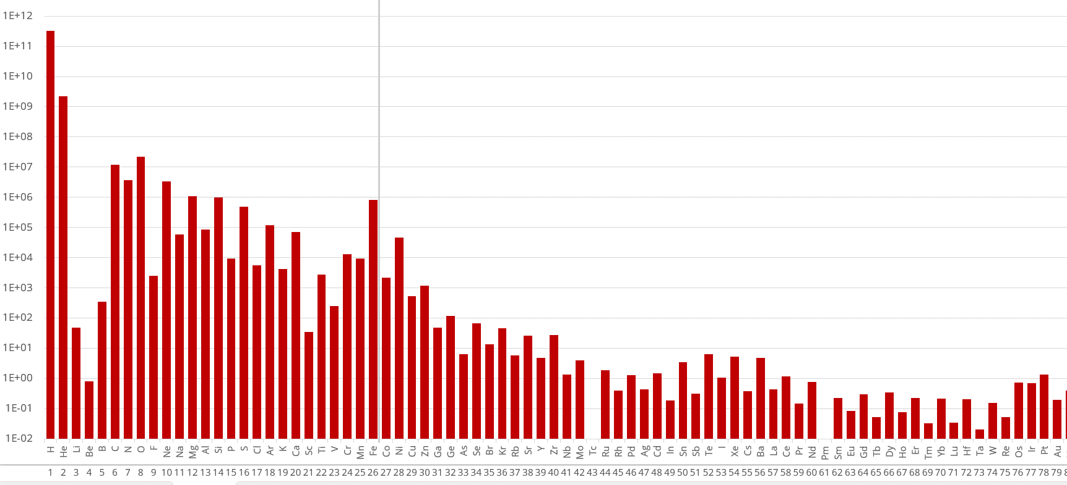
Abundance of the chemical elements (solar system)
Task
Take a look at the abundance distribution. What stands out?
Notes:
Notes for intermediaries:
For this task, return to the previous slide to view the larger image
What students should bear in mind:
In general, the frequency decreases as the atomic number increases
There is a peak in iron, which is marked by the gray line.
A gap in lithium & beryllium
For some elements, the frequency is zero (you might ask the question: "How do we know that these elements actually exist?")
The frequency is higher for elements with an even atomic number
You don't have to explain the observations. But here you can tell them that we will find out the reasons for this chemical frequency distribution during the masterclass

Slide 13
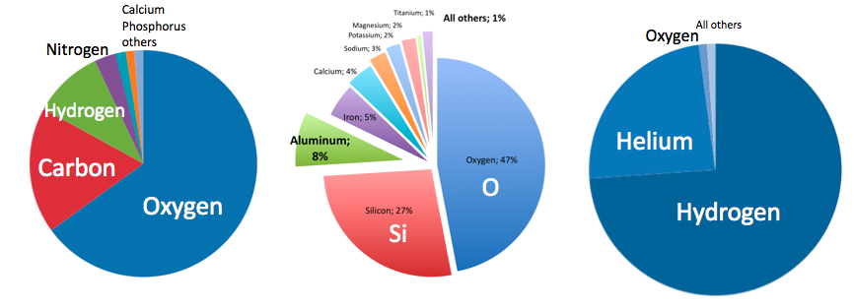
Abundance of the chemical elements
People
Earth's crust
Universe

Slide 14
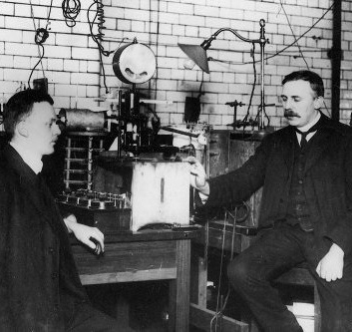
Part I
Atomic nuclei &
their peculiarities

Slide 15
What constitutes a chemical element?

Slide 16
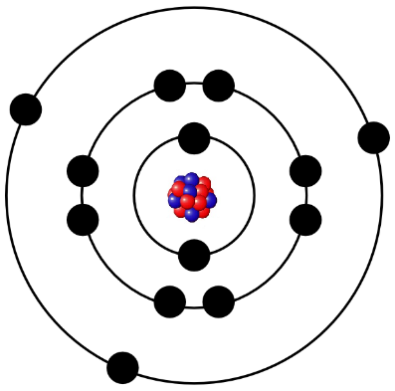
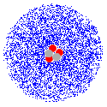
The atomic nucleus
An element is characterized by the number of protons in the atomic nucleus
Example:
Oxygen is the 8th element in the periodic table and has 8 protons
Atomic nucleus
  at the center of the atom
  is 1/10000th of the size of the atom
  combines almost the entire mass of the atom in itself
Notes:
Notes for intermediaries:
For advanced students: Critically discuss Bohr's atomic model and take a brief look at the quantum mechanical properties.
The (outdated) representation with the electron orbits is only used here to tie in with the image of atoms that many students have from chemistry lessons. You are welcome to delete it.

Slide 17
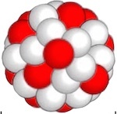
Labeling of atomic nuclei
Atomic nuclei consist of protons and neutrons
Example:
Oxygen has 8 protons and between 4 and 18 neutrons

Slide 18
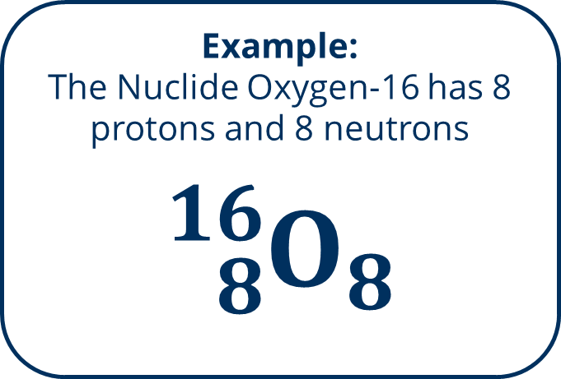
Labeling of atomic nuclei
We call one type of atomic nucleus a nuclide
  is determined by the number of protons and neutrons
Example:
The nuclide oxygen-16 has 8 protons and 8 neutrons
$${}_{8}^{16}{O_{8}}$$

Slide 19
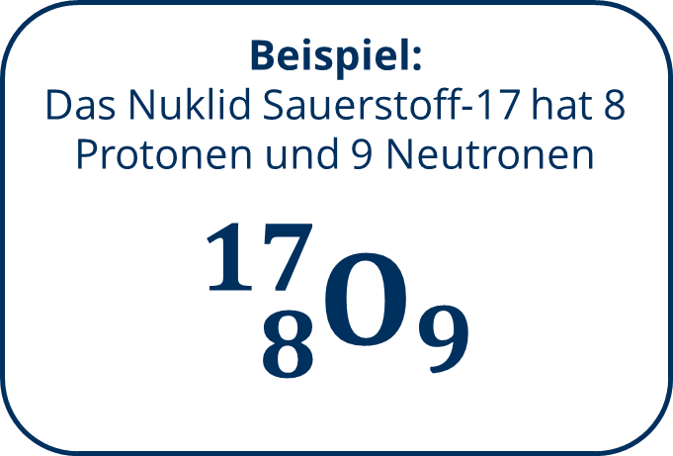
Labeling of atomic nuclei
We call one type of atomic nucleus a nuclide
  is determined by the number of protons and neutrons
Example:
The nuclide oxygen-17 has 8 protons and 9 neutrons
$${}_{8}^{17}{O_{9}}$$

Slide 20
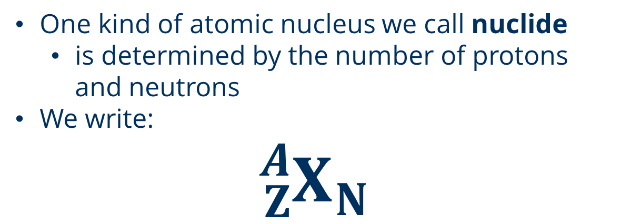
Labeling of atomic nuclei
We call one type of atomic nucleus a nuclide
  is determined by the number of protons and neutrons
We write:
$${}_{Z}^{A}{X_{N}}$$
X... Element symbol
Z... Atomic number / proton number
N... Neutron number
A... Mass number
A = Z + N
Notes:
Notes for intermediaries:
It is very important that the students understand and can use the notation

Slide 21
Labeling of atomic nuclei
Task
How many neutrons does
uranium-238 has?
Mass number A
Chemical symbol
Proton number Z

Slide 22
Labeling of atomic nuclei
Task
Take a look at the nuclide map. To do this, open
2.1 Interactive nuclide chart
Notes:
Notes for intermediaries:
Give them a few minutes to explore the interactive nuclide map. Use this as a transition to the next task with the nuclear reactions.

Slide 23
Where are the
chemical elements
created?

Slide 24
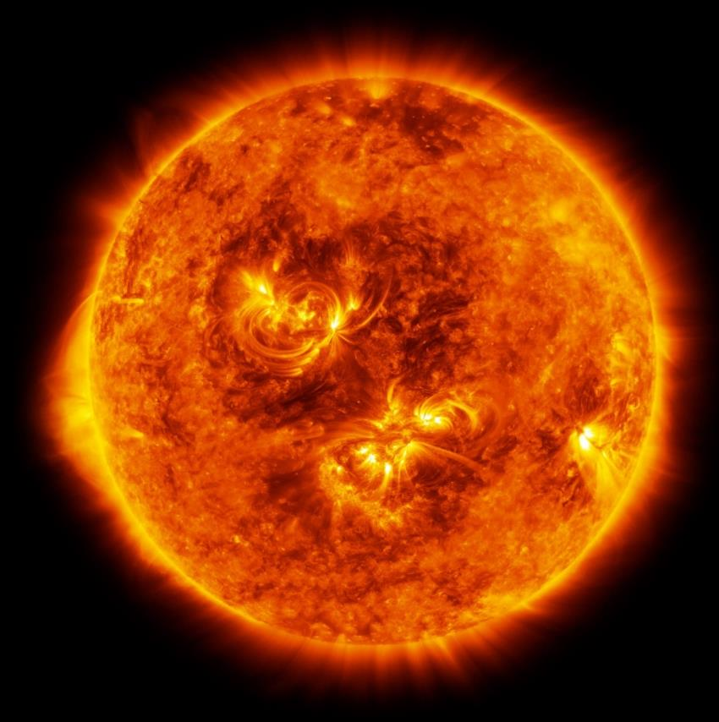
Nuclear reactions
Nuclear fusion or other nuclear reactions can create new atomic nuclei.
These processes are the basis for the formation of new elements!
[06] Illustration of the red supergiant Antares

Slide 25
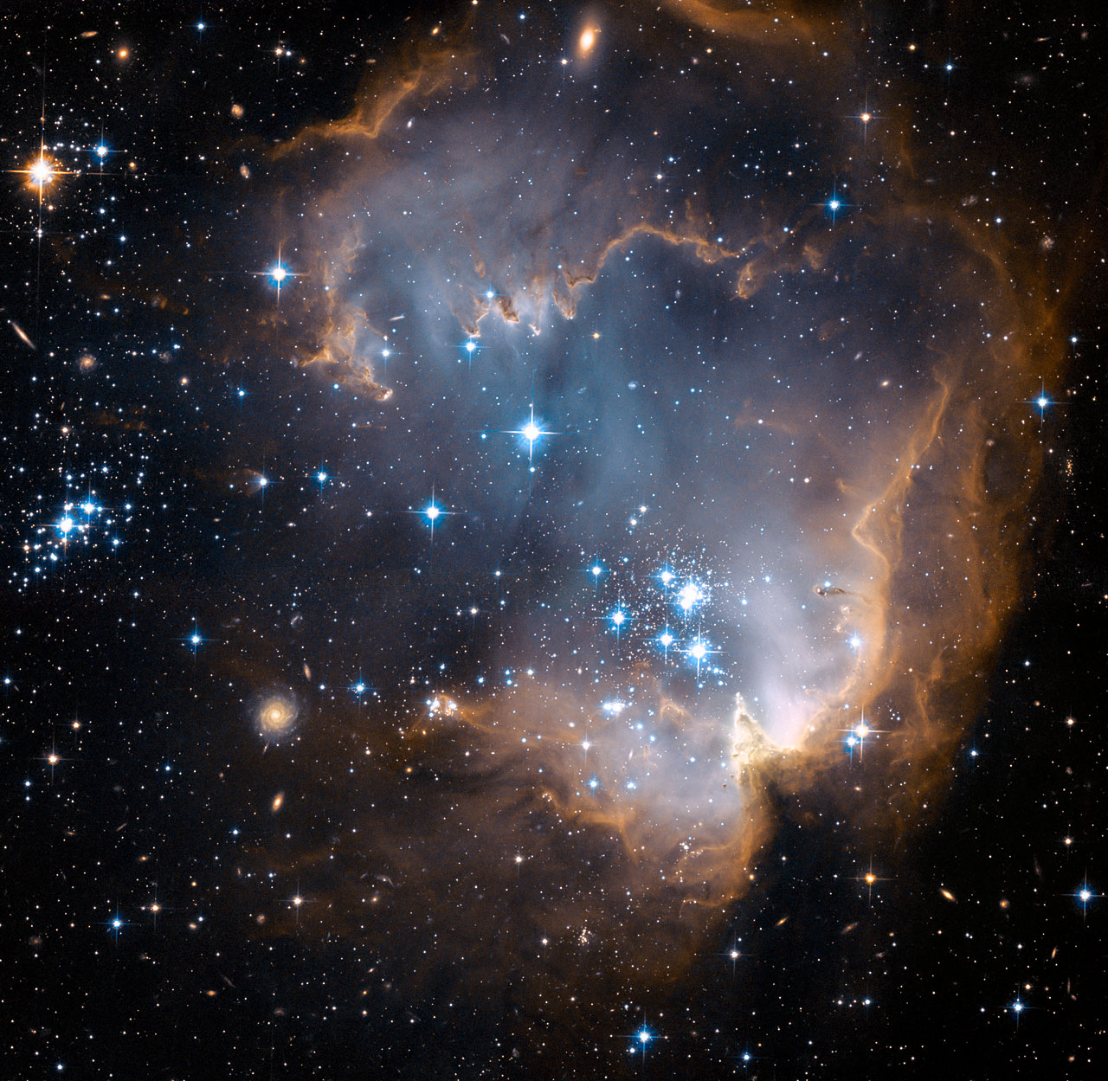
Part II
Stellar
evolution

Slide 26
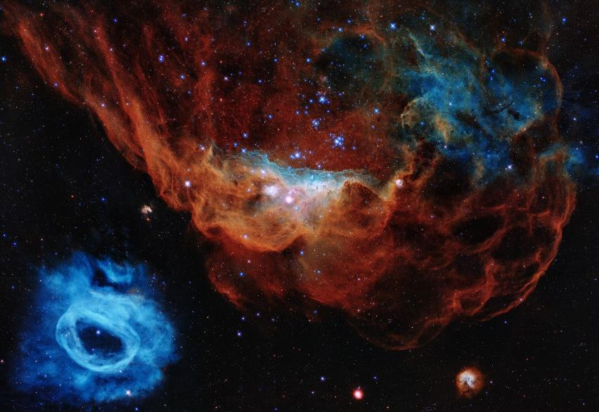
Formation of stars
Around 5 stars form in our Milky Way every year.
The formation takes approx.
1 million - 100 million years
Originally caused by the contraction of interstellar gas clouds (gravitation).
One of these stars is the sun, which was born around 4.6 billion years ago
[08] The two nebulae NGC 2014 and NGC 2020 are part of a star-forming region in the Large Magellanic Cloud, a galaxy 163,000 light years away in the Milky Way.
Hubble/ESA, 2020
Notes:
Notes for intermediaries:
On the following slides, several images are used to show different astronomical objects. You can take a look at the linked sources and add additional information if you wish.

Slide 27
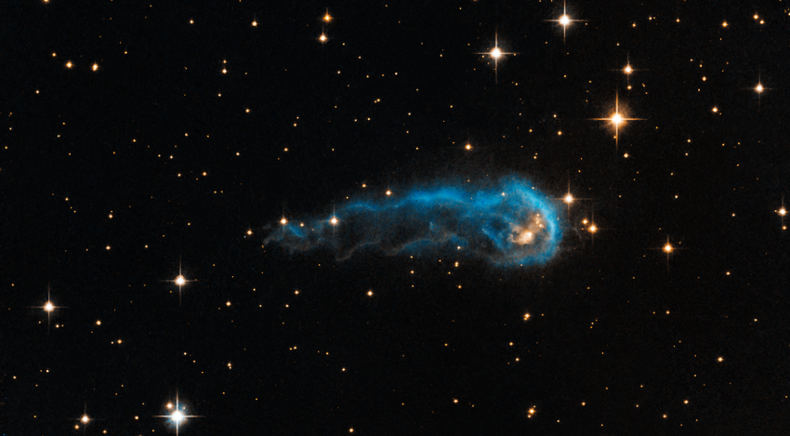
Birth of the sun
0
Billions of years
The contraction of the gas cloud creates a core with a higher density
If the mass is large enough, the cloud collapses and thermal energy is released (gravitational collapse)
If the density of the star is high enough, the radiation can no longer escape from the envelope, so that the star heats up further
[09] The head of the so-called "Cosmic Caterpillar" gas cloud is a protostar that is still absorbing material from its outer shell and slowly condensing.
Hubble/ESA, 2013
Notes:
Notes for intermediaries:
Reduce the explanation of thermodynamic processes to the interaction of the known basic physical quantities (mass, density, temperature).

Slide 28
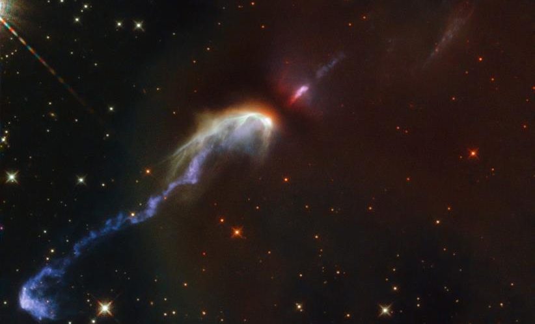
Birth of the sun
0
Billions of years
A protostar is formed
Gravitational force increases
Outer molecules crash into the nucleus
Several thousand Kelvin, light mostly in the infrared range
The temperature is increased until the gas inside is ionized, the gas becomes plasma
[10] Gas ejected from the protostar that hits dust clouds. Two jets are visible, moving diametrically away from the protostar in the center.
Hubble/ESA, 2021
Notes:
Notes for intermediaries:
Reduce the explanation of thermodynamic processes to the interaction of the known basic physical quantities (mass, density, temperature).

Slide 29
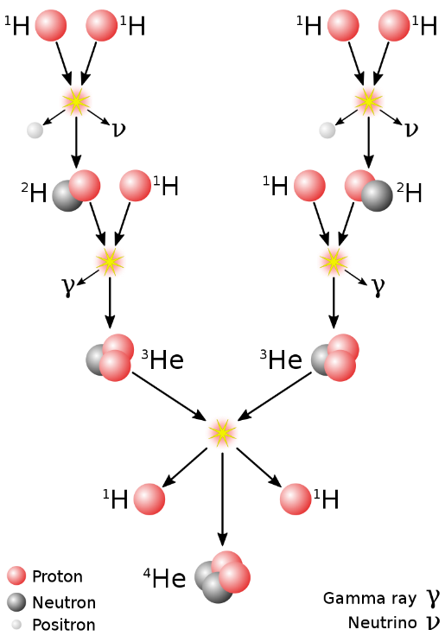
First nuclear fusion
0
0,01
Billions of years
Temperature and density are high enough for the atomic nuclei to overcome the Coulomb barrier
Fusion of hydrogen: Helium is formed and accumulates in the nucleus
Radiation & gas pressure as a counterforce to the gravitational force
The star has reached a stable state!
Hydrostatic equilibrium: gravity and pressure in equilibrium
Notes:
Notes for intermediaries:
Reduce the explanation of thermodynamic processes to the interaction of the known basic physical quantities (mass, density, temperature).

Slide 30
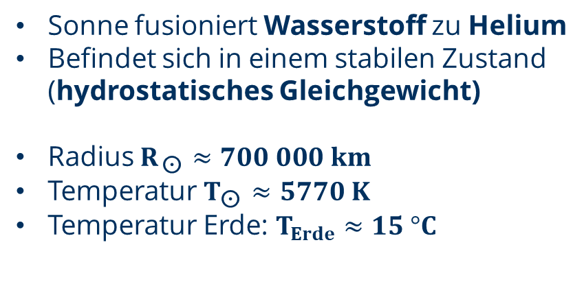
Yellow dwarf (Today)
0
0,01
4,6
Billions of years
Sun fuses hydrogen into helium
Is in a stable state (hydrostatic equilibrium)
Radius
Temperature
Earth temperature:
Notes:
Notes for intermediaries:
Reduce the explanation of thermodynamic processes to the interaction of the known basic physical quantities (mass, density, temperature).

Slide 31


Nuclear fusion
$${}_{1}^{1}H+{}_{1}^{1}H→{}_{1}^{2}H+e^{+}+ν$$
$${}_{1}^{2}H+{}_{1}^{1}H→{}_{2}^{3}{He+}$$
$${}_{2}^{3}{{He}_{1}}+{}_{2}^{3}{{He}_{1}}→{}_{2}^{4}{{He}_{2}+}{}_{1}^{1}{H_{0}}+{}_{1}^{1}{H_{0}}$$
Notes:
Notes for intermediaries:
Only deal with the reaction chain shown in general terms. The students do not have to memorize it
Explain the stable state of a star: gravitational force = radiation pressure
=> Star needs fusion processes for stable state!

Slide 32
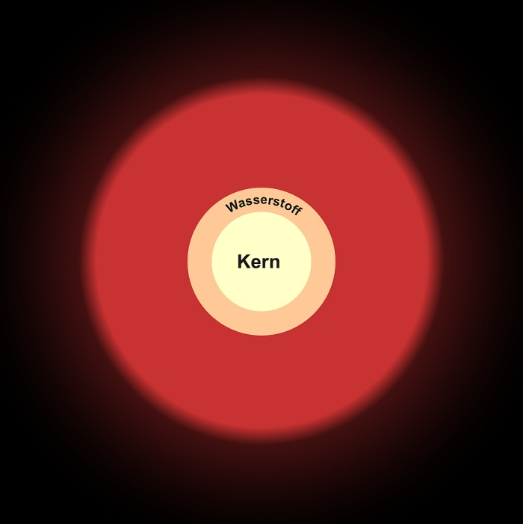
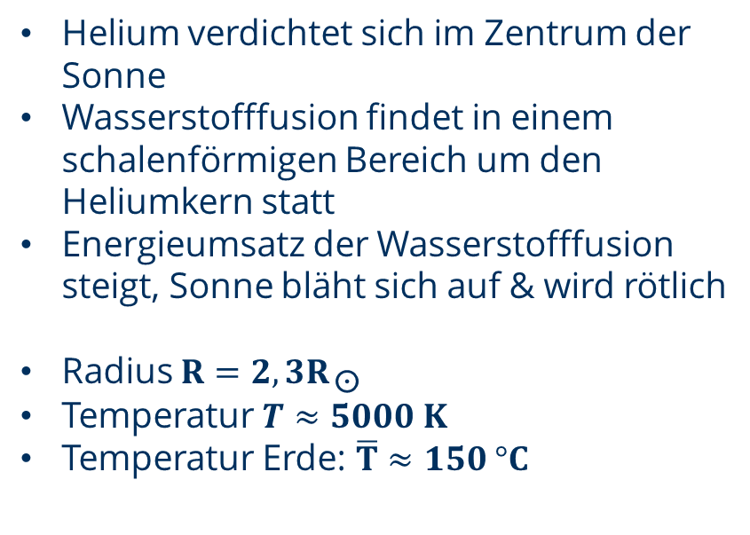
Transition phase
0
0,01
4,6
11
Billions of years
Helium condenses in the center of the sun
Hydrogen fusion takes place in a shell-shaped area around the helium nucleus
Energy turnover of hydrogen fusion increases, sun inflates & becomes reddish
Radius
Temperature
Earth temperature:
Notes:
Notes for intermediaries:
Reduce the explanation of thermodynamic processes to the interaction of the known basic physical quantities (mass, density, temperature).

Slide 33
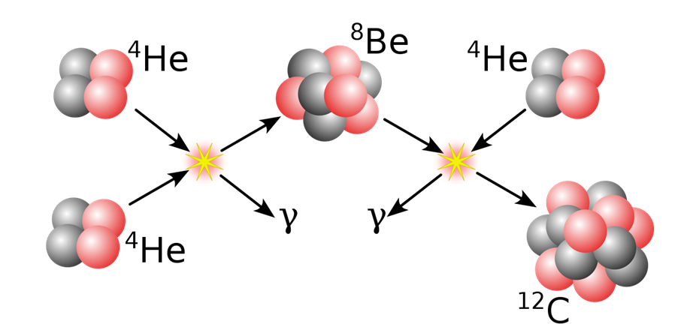
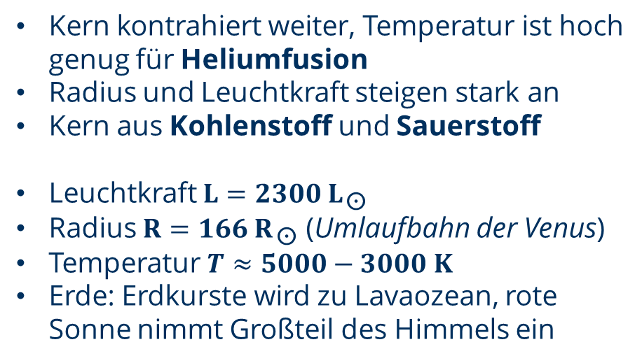
Red giant
0
0,01
4,6
11
12
Billions of years
Core continues to contract, temperature is high enough for helium fusion
Radius and luminosity increase significantly
Carbon and oxygen core
Luminosity
Radius (orbit of Venus)
Temperature
Earth: Earth's crust becomes a lava ocean, red sun occupies most of the sky
Notes:
Notes for intermediaries:
Reduce the explanation of thermodynamic processes to the interaction of the known basic physical quantities (mass, density, temperature).

Slide 34
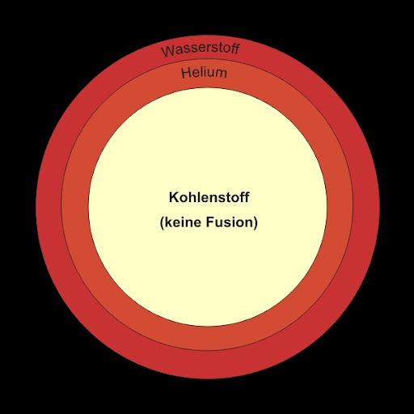
Red giant
0
0,01
4,6
11
12
Billions of years
Core continues to contract, temperature is high enough for helium fusion
Radius and luminosity increase significantly
Carbon and oxygen core
Luminosity
Radius (orbit of Venus)
Temperature
Earth: Earth's crust becomes a lava ocean, red sun occupies most of the sky
Notes:
Notes for intermediaries:
Reduce the explanation of thermodynamic processes to the interaction of the known basic physical quantities (mass, density, temperature).

Slide 35
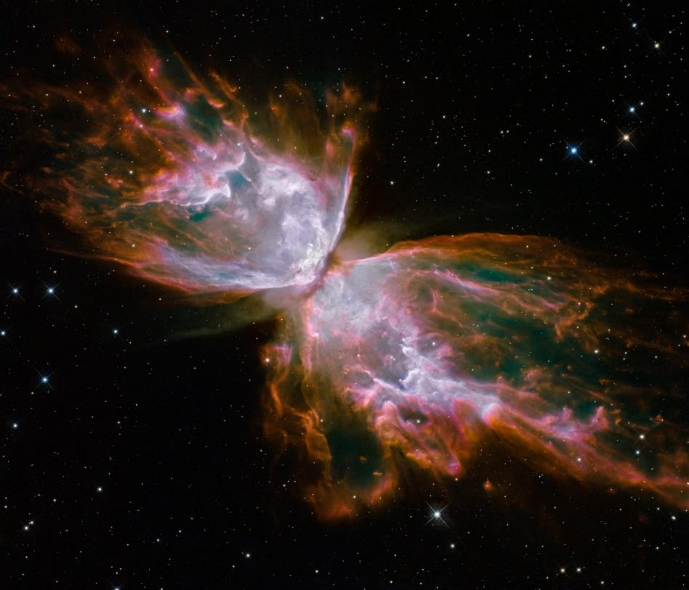
Planetary nebula
0
0,01
4,6
11
12
12,4
Billions of years
Sun goes through unstable phase during helium burning, in which radius, temperature & luminosity fluctuate extremely
At the end of the unstable phase, the star ejects its shell
The inner core of carbon and oxygen is released
Notes:
Notes for intermediaries:
Reduce the explanation of thermodynamic processes to the interaction of the known basic physical quantities (mass, density, temperature).

Slide 36
Planetary nebula
[13] The planetary nebula NGC 6302, also known as the Butterfly Nebula, is located in our Milky Way, about 3800 Lj away. At its center is a dying star that had five times the mass of the sun. It has shed its gaseous envelope and is now releasing a stream of UV radiation that makes the ejected matter visible.
Hubble/ESA, 2009
Notes:
Notes for intermediaries:
These objects are used as examples to give students an insight into the various phenomena of stellar evolution

Slide 37
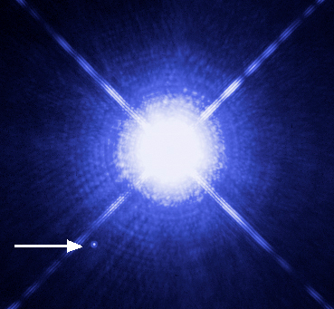
White dwarf
0
0,01
4,6
11
12
12,4
12,4 - 14
Billions of years
Exposed nucleus forms a white dwarf
No more nuclear fusion "burnt-out star corpse"
Extremely high mass density, remains in a stable state due to degeneration pressure
About 0.5 to 1 times the mass of today's sun and the radius of the Earth
No energy source, slowly goes out and becomes a black dwarf
[14] Double star system Sirius A and Sirius B. Sirius B is a white dwarfGas ejected from the protostar that encounters dust clouds. Two jets are visible moving diametrically away from the protostar in the center.
Hubble/ESA
Notes:
Notes for intermediaries:
Reduce the explanation of thermodynamic processes to the interaction of the known basic physical quantities (mass, density, temperature).

Slide 38
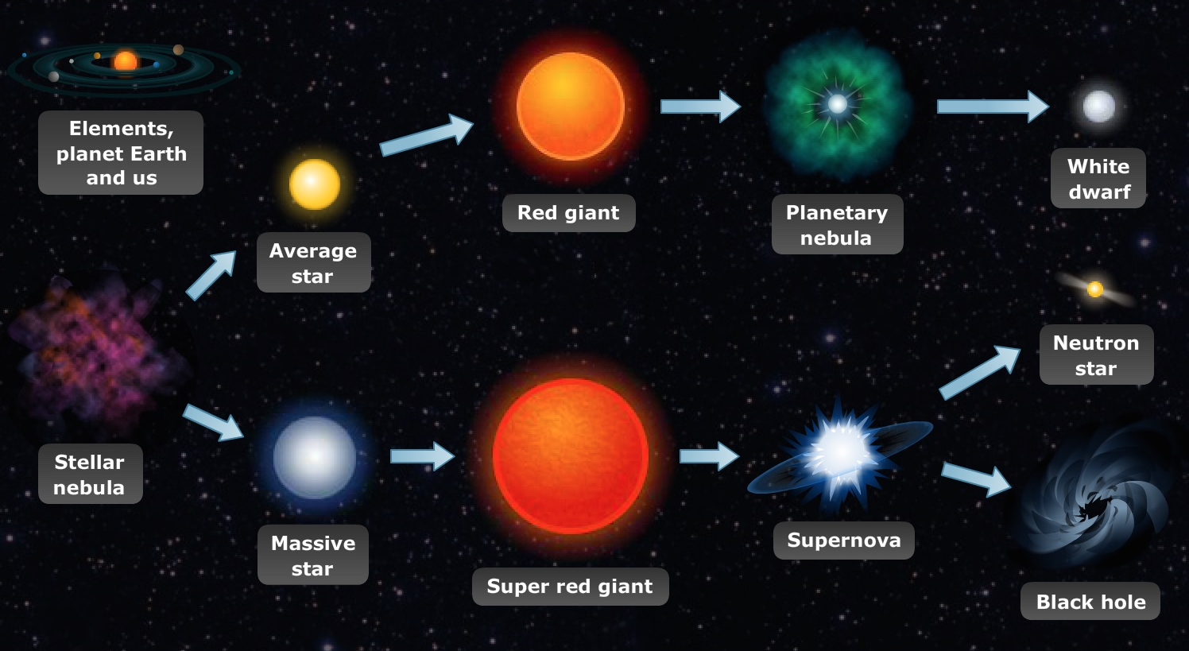
Development of stars
[15] Life phases of the stars

Slide 39
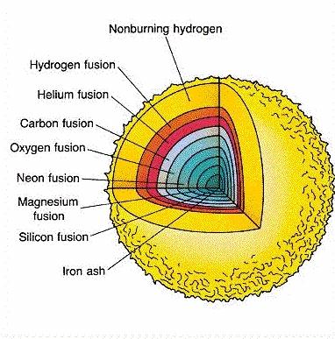
Development of stars
The higher the chemical element, the higher the Coulomb barrier
If the temperature and density are high enough, helium fusion becomes possible
Depending on the mass of the star, further elements can merge
The star goes through phases of life that are linked to the nuclear fusion processes

Slide 40
Abundance of the chemical elements (solar system)

Slide 41
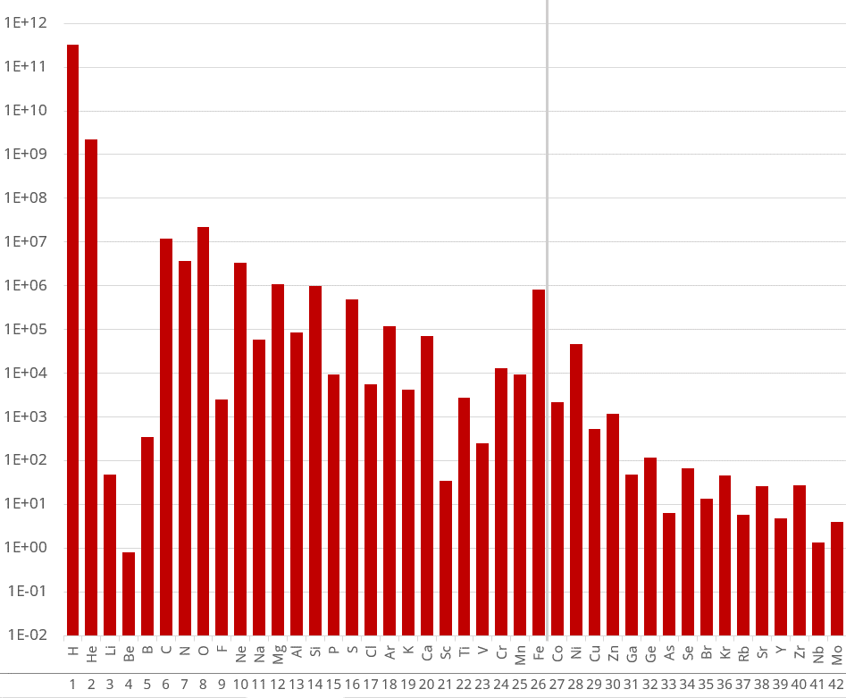
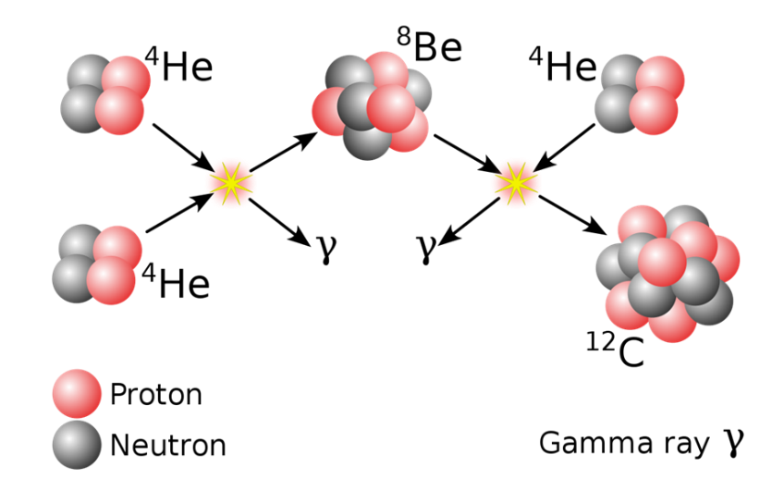
Abundance of chemical elements (solar system)
Notes:
Notes for intermediaries:
Now we can use our understanding of the processes in stars to explain the elemental abundances. The lithium gap can be explained by the 3a process, which skips Li and Be. Be8 is only an unstable intermediate state (due to the higher binding energy of helium)

Slide 42
Abundance of the chemical elements (solar system)
Elements up to iron can be synthesized by nuclear fusion in stellar processes
This results in an increased iron content
Notes:
Notes for intermediaries:
The term "stellar processes" is used here in a very general sense
Of course, most chemical elements are not formed by simple mergers in stable stars, as previously shown, but in exploding massive stars, exploding white dwarfs, etc.
Decide how detailed you want to go here, depending on the students' level of knowledge

Slide 43

Abundance of chemical elements (solar system)
Notes:
Notes for intermediaries:
The term "stellar processes" is used here in a very general sense
Of course, most chemical elements are not formed by simple mergers in stable stars, as previously shown, but in exploding massive stars, exploding white dwarfs, etc.
Decide how detailed you want to go here, depending on the students' level of knowledge

Slide 44
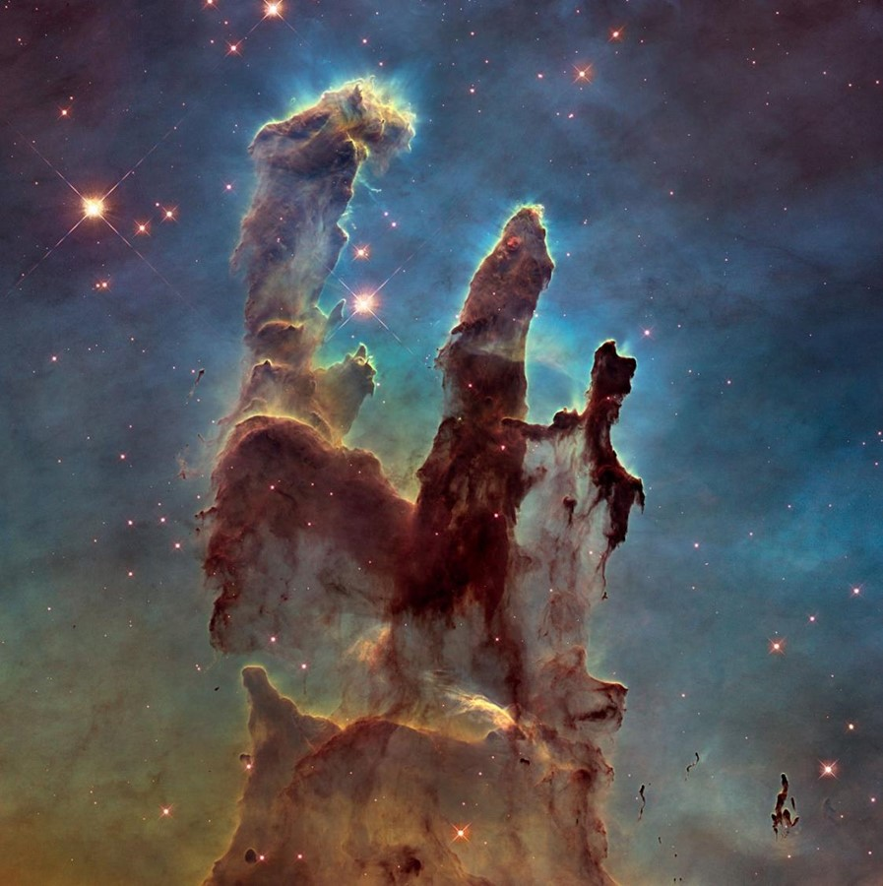

Slide 45
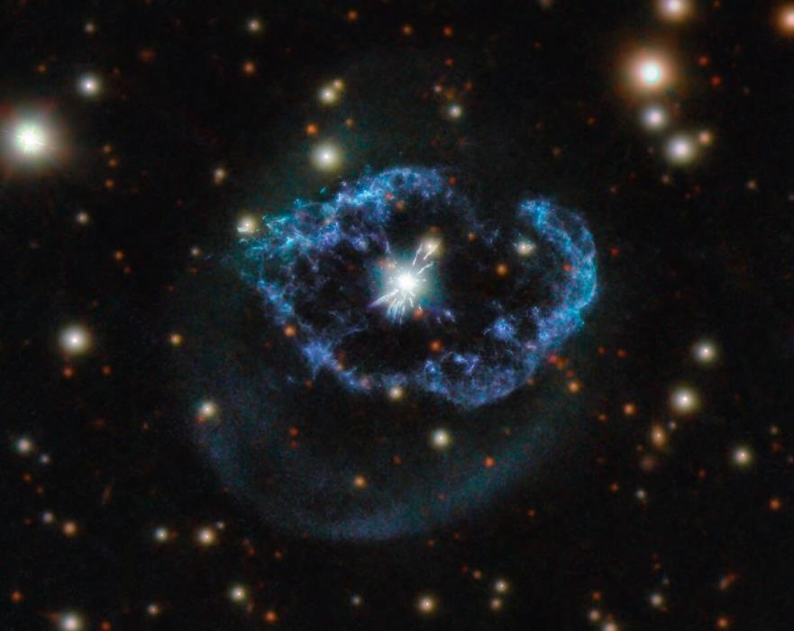

Slide 46
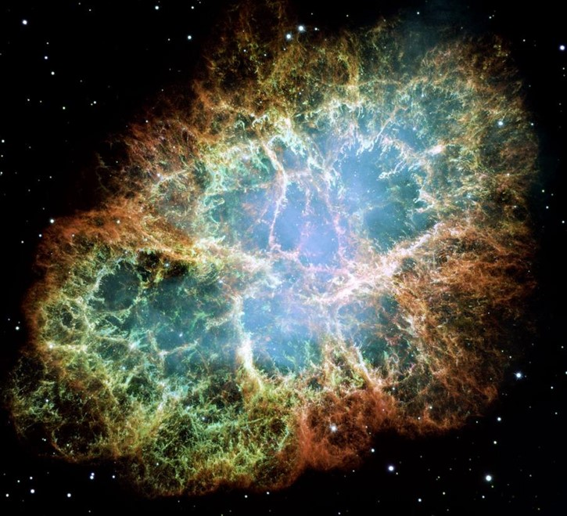

Slide 47

Part III
Primordial nucleosynthesis

Slide 48
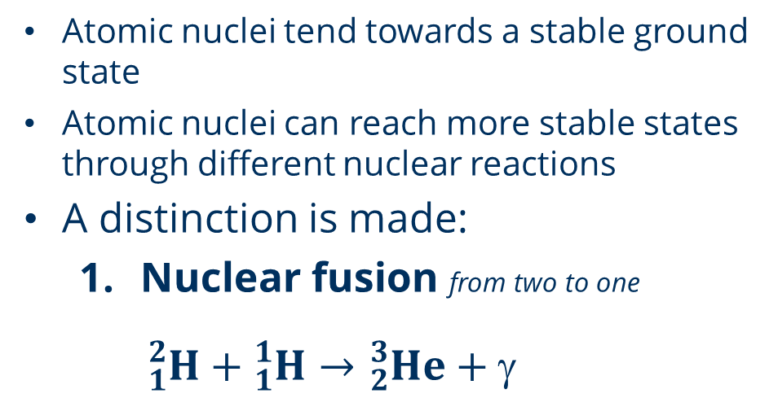
Nuclear reactions
Atomic nuclei tend towards a stable ground state
Atomic nuclei can reach more stable states through different nuclear reactions
A distinction is made:
  Nuclear fusion from two to one
  ${}_{1}^{2}H+{}_{1}^{1}H→{}_{2}^{3}{He+}$

Slide 49
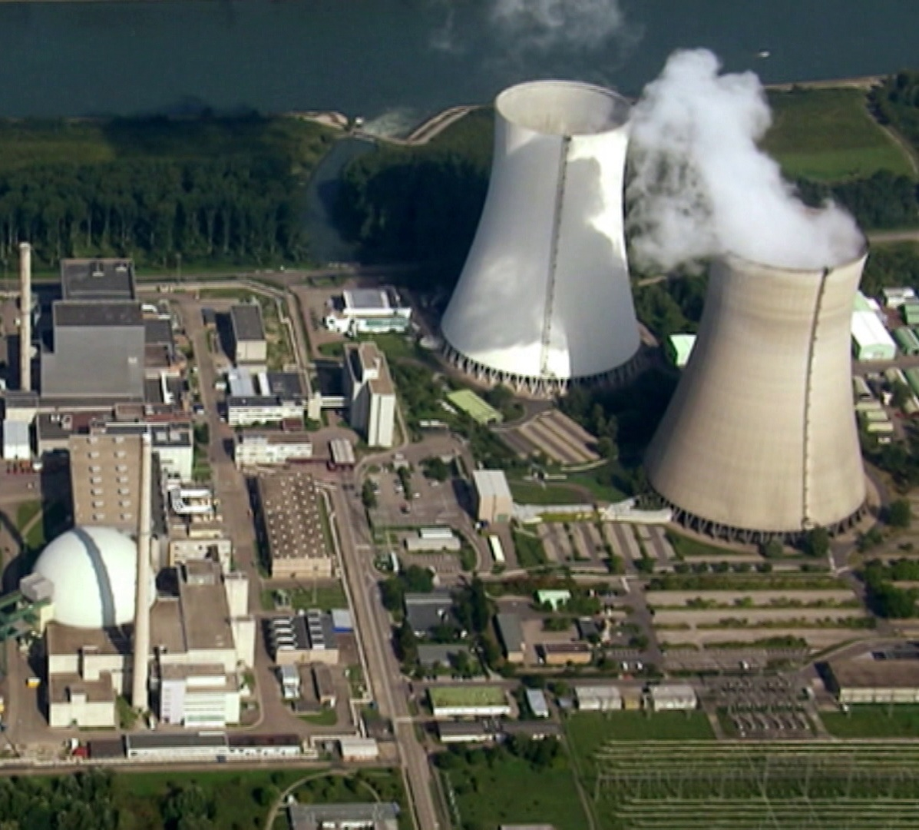
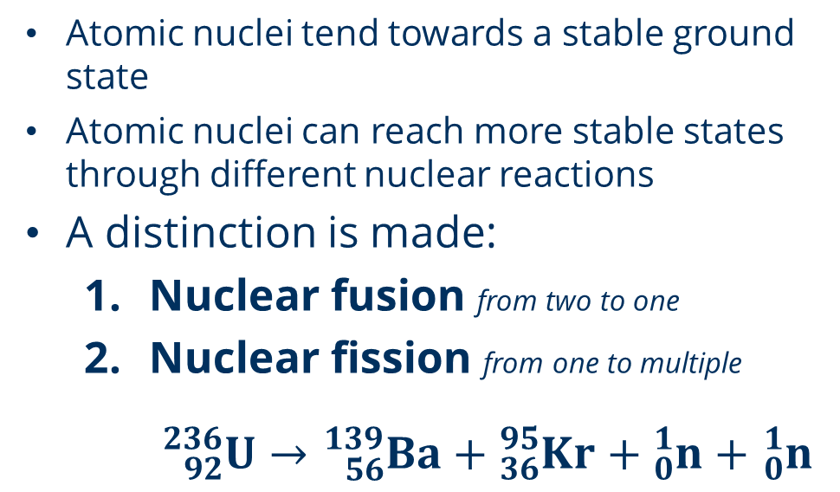
Nuclear reactions
Atomic nuclei tend towards a stable ground state
Atomic nuclei can reach more stable states through different nuclear reactions
A distinction is made:
  Nuclear fusion from two to one
  Nuclear fission from one to multiple
  ${}_{92}^{236}U→{}_{56}^{139}{Ba}+{}_{36}^{95}{Kr}+{}_{0}^{1}n+$ ${}_{0}^{1}n$

Slide 50

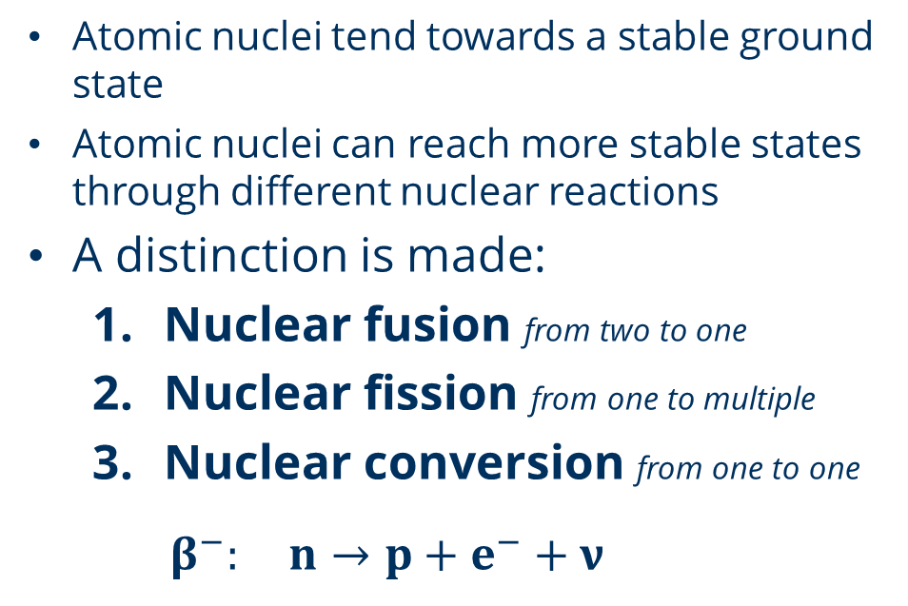
Nuclear reactions
Atomic nuclei tend towards a stable ground state
Atomic nuclei can reach more stable states through different nuclear reactions
A distinction is made:
  Nuclear fusion from two to one
  Nuclear fission from one to multiple
  Nuclear conversion from one to one
  $β^{−}: n→p+e^{−}+ν$

Slide 51
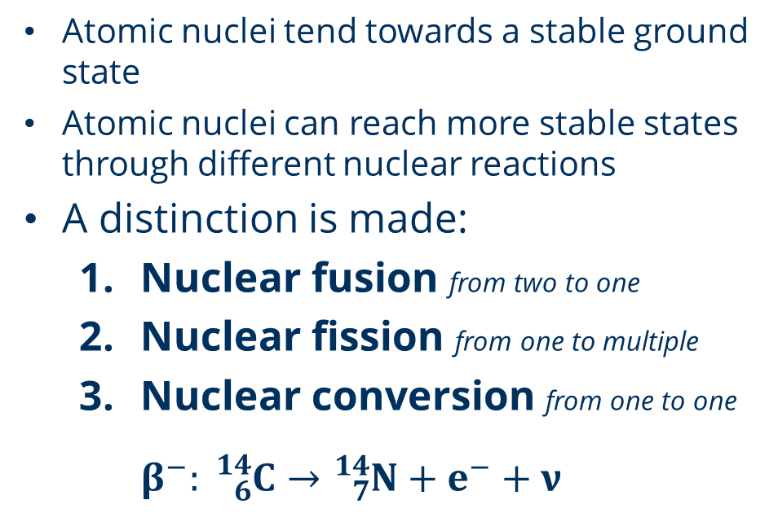
Nuclear reactions
Atomic nuclei tend towards a stable ground state
Atomic nuclei can reach more stable states through different nuclear reactions
A distinction is made:
  Nuclear fusion from two to one
  Nuclear fission from one to multiple
  Nuclear conversion from one to one
  $β^{−}: {}_{6}^{14}C→{}_{7}^{14}N+e^{−}+ν$

Slide 52
The Primordial Puzzle
Task
Reconstruct the
reaction network of
primordial nucleosynthesis
Notes:
Notes for intermediaries:
If you want to simplify it, use the "skateboard in a halfpipe" analogy. The skateboard wants to go to the "lowest state" in the middle of the pipe and will not go up unless it is stimulated. In general (greatly simplified), the further away from the valley a nuclide is, the more unstable it is. The same applies to the skateboard, which is faster when it starts at the top of the halfpipe.

Slide 53

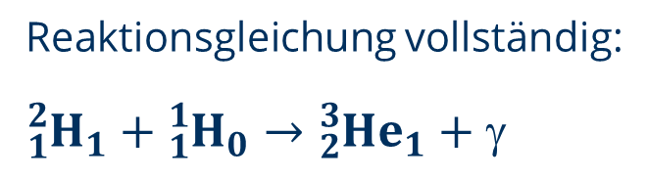


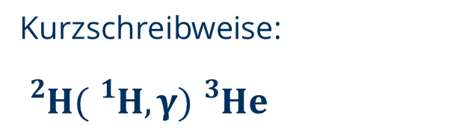
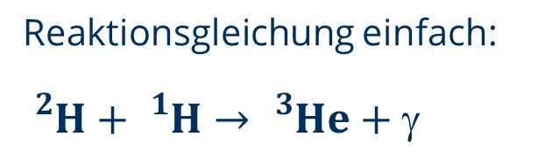
Nuclear reactions
Reaction equation complete:
Reaction equation visualized:
p
$${}_{}^{3}{He}$$
Reaction equation simple:
$$({}_{}^{1}H,γ)$$
$${}_{}^{2}H$$
Abbreviation:
n

Slide 54
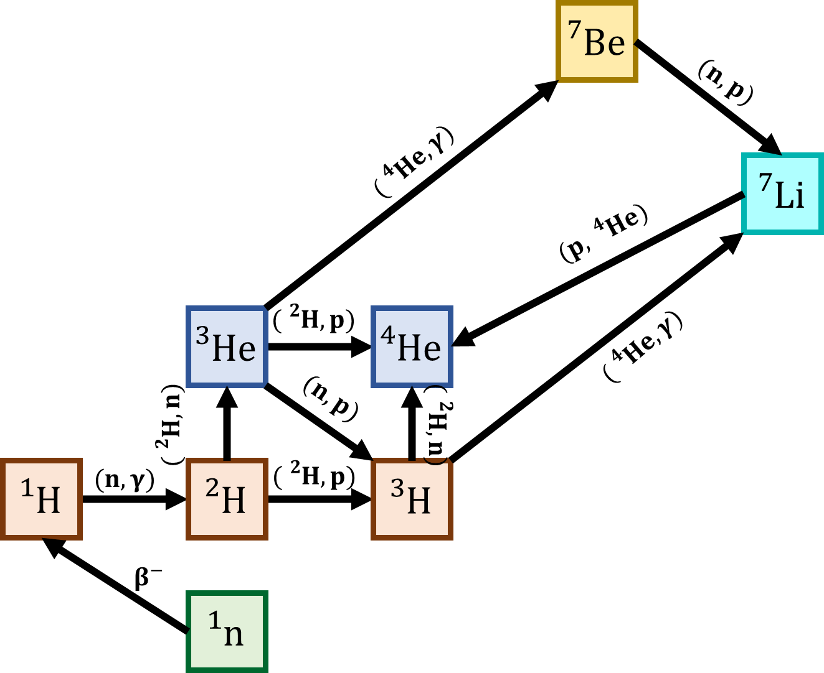
Solution: Primordial nucleosynthesis
Notes:
Notes for intermediaries:
After the part about stellar evolution, the concept of binding energy is used to explain the chemical abundances. But at this point, you could already explain the iron peak and the lithium gap.

Slide 55
Primordial nucleosynthesis
https://www.youtube.com/watch?v=37at8bzfixw&list=PLy6RW7KnCL_e2aiOvCsDPcn7R08HHbBJZ&index=3
Notes:
Notes for intermediaries:
After the part about stellar evolution, the concept of binding energy is used to explain the chemical abundances. But at this point, you could already explain the iron peak and the lithium gap.

Slide 56
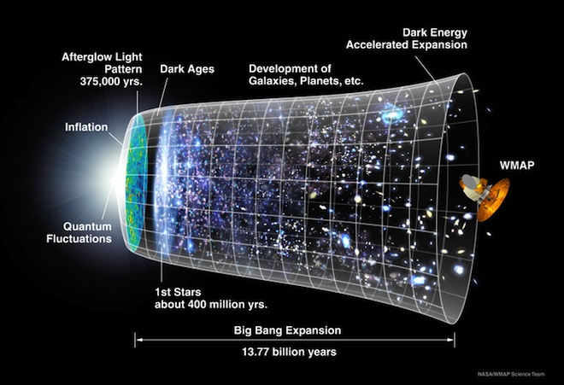

Slide 57

B²FH-Paper
"It is the stars, the stars above us, govern our conditions"
- King Lear (Shakespeare), Act IV, Scene 3
Technical article published in 1957
"Synthesis of the Elements in Stars" by Margaert & Geoffrey Burbidge, William Fowler & Fred Hoyle
Explanation of the formation of the elements:
  Nuclear fusion (also 3-alpha process), as well as first theories on nucleosynthesis of higher elements
  Explanation of the relative abundance of chemical elements
Fred Hoyle
  Critic of the Big Bang theory and inventor of its name
  Steady-state theory
Fred Hoyle
Notes:
Notes for intermediaries:
If you want to simplify it, use the "skateboard in a halfpipe" analogy. The skateboard wants to go to the "lowest state" in the middle of the pipe and will not go up unless it is stimulated. In general (greatly simplified), the further away from the valley a nuclide is, the more unstable it is. The same applies to the skateboard, which is faster when it starts at the top of the halfpipe.

Slide 58
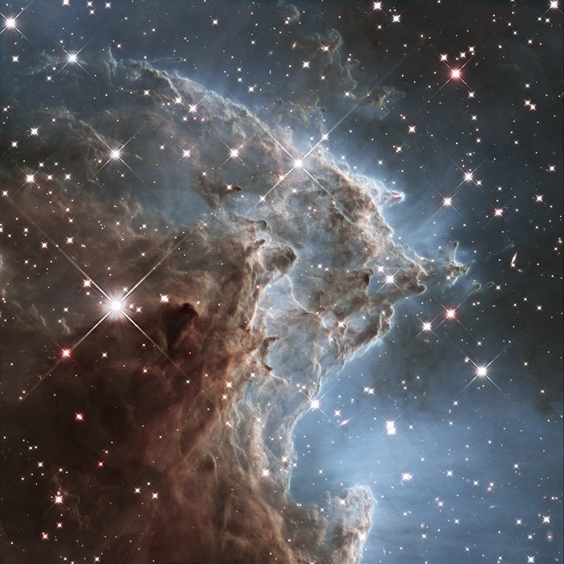
Part IV
Fingerprints
of the stars

Slide 59
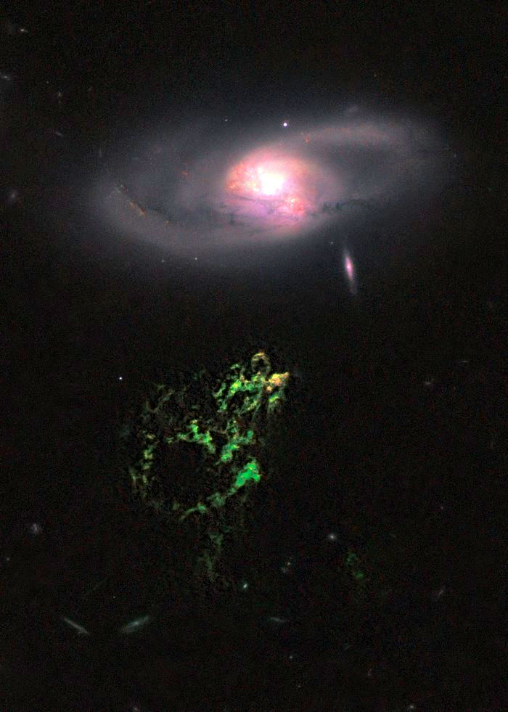

Slide 60
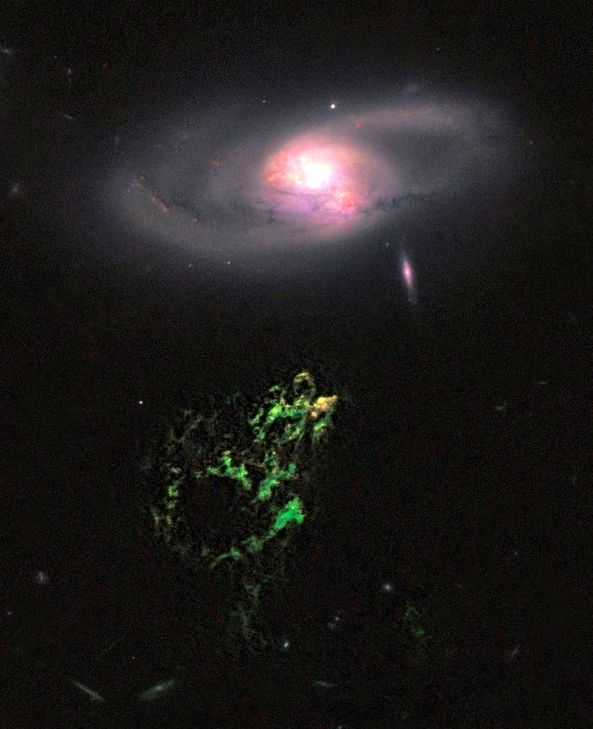
Hanny's Voorwerp
[21] Hanny's Voorwerp is the only visible part of a gas cloud that extends around the galaxy IC 2497 at a distance of 300,000 light years. The object is visible because a beam from the core of the galaxy illuminates it. This ray originates from a quasar that has probably gone out in the last 200,000 years. Henny's Voorwerp is as large as the Milky Way, and its bright green color comes from glowing oxygen.
Hubble/ESA, 2011

Slide 61
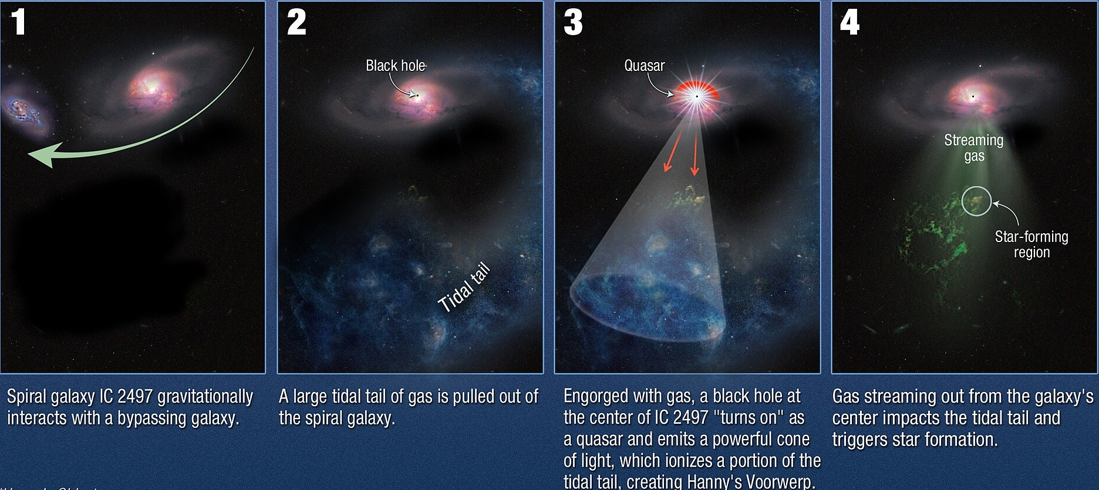
Hanny's Voorwerp

Slide 62
Question
How can we learn about the cosmos?

Slide 63
Question
How can we learn about the cosmos?
Answer
Light!

Slide 64
What is light?
Notes:
Notes for intermediaries:
Give the students time to think about this question.
If they can remember the Coulomb limit and the various nuclear reactions from the group puzzle, it should occur to them that neutron capture could be an important process for this.

Slide 65



Light is ...
... an electromagnetic wave
  = an electric field and a magnetic field, which oscillate perpendicular to each other
  in space (in phase)
  Spreads at the
  at the speed of light
    in a vacuum:
    $E=h∙f=h∙\frac{c}{λ}$
... Planck's quantum of action

Slide 66


Light is ...
... an electromagnetic wave
  = an electric field and a magnetic field, which oscillate perpendicular to each other
  in space (in phase)
  Spreads at the
  at the speed of light
    in a vacuum:
    General:
... electric field constant
... magnetic field constant
... permeability
... dielectric constant

Slide 67


Light is ...
... a particle
  = electromagnetic radiation, which consists of oscillating energy quanta
    Photons
  Detection: Photoelectric effect
  Photons carry "energy portions"
... Planck's quantum of action

Slide 68
What color is a star?
Notes:
Notes for intermediaries:
Give the students time to think about this question.
If they can remember the Coulomb limit and the various nuclear reactions from the group puzzle, it should occur to them that neutron capture could be an important process for this.

Slide 69



Light is ...
$c=λ∙f$
... speed of light
... wavelength
... frequency

Slide 70

Wavelength [nm]
Notes:
Notes for intermediaries:
The stability principle explains why only certain areas in the HRD are "occupied" by stars

Slide 71
Data analysis
Task
Analyze the spectra of stars and measure the elemental abundances. To do this, complete the tasks on the
3.1 Data analysis worksheet
using the online tool
3.2 WebSME
Notes:
Notes for intermediaries:
Give them a few minutes to explore the interactive nuclide map. Use this as a transition to the next task with the nuclear reactions.

Slide 72
Metallicity

Slide 73
Metallicity
Metals

Slide 74

... Lithium is rare
  Lithium abundance is mainly due to primordial nucleosynthesis
  The Big Bang model predicts a higher lithium abundance than is measured in the cosmos
Notes:
Notes for intermediaries:
The stability principle explains why only certain areas in the HRD are "occupied" by stars

Slide 75

... Lithium is rare
  Lithium abundance is mainly due to primordial nucleosynthesis
  The Big Bang model predicts a higher lithium abundance than is measured in the cosmos
The primordial lithium problem
  Atomic diffusion?
  Spallation processes?
  Nuclear reactions inaccurately determined?
  Big Bang theory flawed?
Notes:
Notes for intermediaries:
The stability principle explains why only certain areas in the HRD are "occupied" by stars

Slide 76
Frequency of chemical elements (solar system)

Slide 78
Nuclides
Stars
Cosmos
Why is lithium so rare?
$ 100
Why do stars rotate?
Which nuclides were created immediately after the Big Bang?
$ 100
$ 100
Why is the Earth's core mainly made of nickel and iron?
Why do spectra of stars have absorption lines?
How does the expansion of the universe work?
$ 200
$ 200
$ 200
Why does radioactivity exist at all?
What is a star?
What came before the Big Bang?
$ 300
$ 300
$ 300

Slide 79
Astro-Jeopardy: List of all questions (this page will be deleted later)
Nuclides
100: Why is lithium so rare
200: Why is the Earth's core mainly made of nickel and iron?
300: Why does radioactivity exist at all?
Stars
100: Why do stars rotate?
200: Why do spectra of stars have absorption lines?
300: What is a star?
Cosmos
100: Which chemical elements were created immediately after the Big Bang?
200: How does the expansion of the universe work?
300: What came before the Big Bang?

Slide 80
Brainstorming
Task
Open the
1. brainstorming board
Discuss your answers from the beginning. Would you answer some of the questions differently now?

Slide 81

Summary
Nuclear astrophysics is a complex interplay of nuclear physics experiments, stellar models, astronomical observations, etc.
Chemical elements are created in the processes that drive our entire universe
The abundance of chemical elements is an indicator of cosmic evolution
With the help of nuclear astrophysics, we are trying to reconstruct the history and development of our universe.

Slide 82
Abundance of the chemical elements (solar system)

Slide 83




Nuclear astrophysics
Astronomical observation
Nuclear astrophysics
Computational Modeling
Nuclear reactions

Slide 84





A lot of unanswered questions
How are the heavy elements created?
How does a galaxy evolve?
What happens in a neutron star and when neutron stars merge?
What can we learn about the Big Bang with the help of nuclear astrophysics?
Today we have only scratched the surface of the world of nuclear astrophysics!
[26]
[25] Starbust Galaxy M82
[01] Pillars of Creation
Notes:
Notes for intermediaries:
Attention, a few animations on this slide
It is important to make the students realize that we have only put a toe into the scientific field of nuclear astrophysics.
The aim here is not to answer all questions, but rather to raise further questions in order to motivate people to engage with the topic even after the masterclass.

Slide 85
The end of a journey through the elements

